Slide 1

RIGHT OUTER JOIN
The RIGHT JOIN combines data from two or more tables. The RIGHT JOIN clause starts selecting data from the right table and matching with the rows from the left table. The RIGHT JOIN returns a result set that includes all rows in the right table, whether or not they have matching rows from the left table. If a row in the right table does not have any matching rows from the left table, the column of the left table in the result set will have nulls.
Infoway Technologies, 3rd Floor Commerce Centre, Rambaug Colony, Paud Road Pune 411038

Slide 2
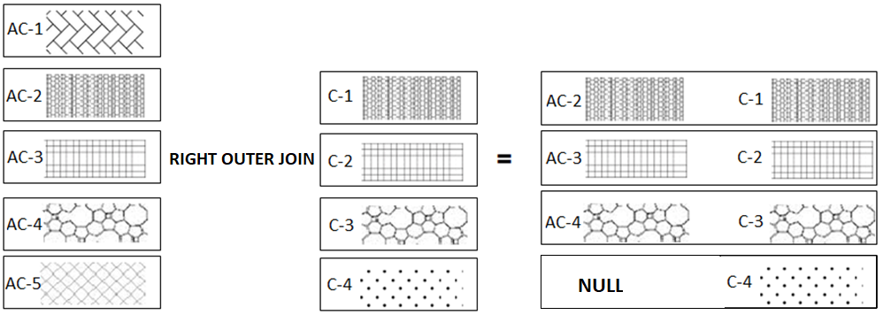
Suppose, we want to join two tables: A and B. Right outer join returns all rows in the right table (A) and all the matching rows found in the left table (B). It means the result of the SQL right join always contains the rows in the right table. . If no matching rows found in the left table, NULL are displayed.
The following example the RIGHT OUTER JOIN of two tables T1(AC-1, AC-2, AC-3, AC-4, AC-5) and T2(C-1, C-2, C-3, C-4). The RIGHT JOIN will match rows from the T1 table with the rows from T2 table using patterns:
Infoway Technologies, 3rd Floor Commerce Centre, Rambaug Colony, Paud Road Pune 411038

Slide 3
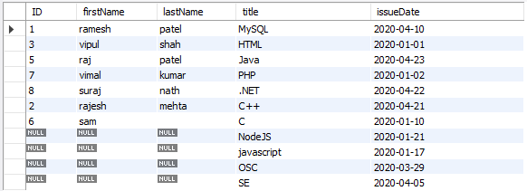
Left Outer Join
syntex
SELECT column-list from <table_references> RIGHT [OUTER ] JOIN <table_references> ON table1.column-name = table2.column-name
SELECT student.ID, firstName, lastName, title, issueDate FROM student RIGHT OUTER JOIN library ON student.ID = library.studentID;

